Slide 1

FA17IS590- Internet of Things
Final Project – GPS Tracker
Submitted by: Niteesh Kanungo, Pratik Shrivastava
Instructor: Mark Moran
University of Illinois at Urbana-Champaign

Slide 2
Agenda
Problem Statement & Motivation
Business Model Canvas
Raspberry Pi and GPS
AWS
Geofencing
Demo
Questions

Slide 3

Problem Statement & Motivation
Main objective for the project
Designing and Working of the IOT system from scratch.
Working with Raspberry Pi, Sensors and AWS Cloud Technology to understand how the implementation is done at the software level and how each part within the ecosystem works as a network.
Understanding Application of system as per Business needs.
Main motivation
We can track stolen Goods, Cargos, kids and Dogs everything with the help of one single product.
We are trying to make this project as cost effective as possible.
Product will have very low Power Consumption and will be smart enough to change communication protocols as available to increase the life on single charge.
Also, the product will be IP67 Weather and dust protected.

Slide 4
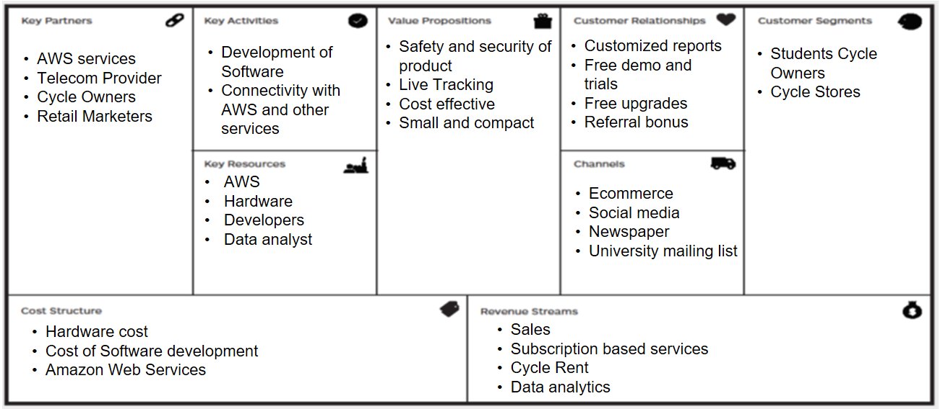
Business Model Canvas

Slide 5

Raspberry Pi 3 and GPS
Hardware:
Raspberry pi 3
U-blox neo-6m gps with active antenna.
Software:
Raspbian OS:
Python libraries: serial, pynmea2, haversine, AWSIoTPythonSDK.MQTTLib

Slide 6
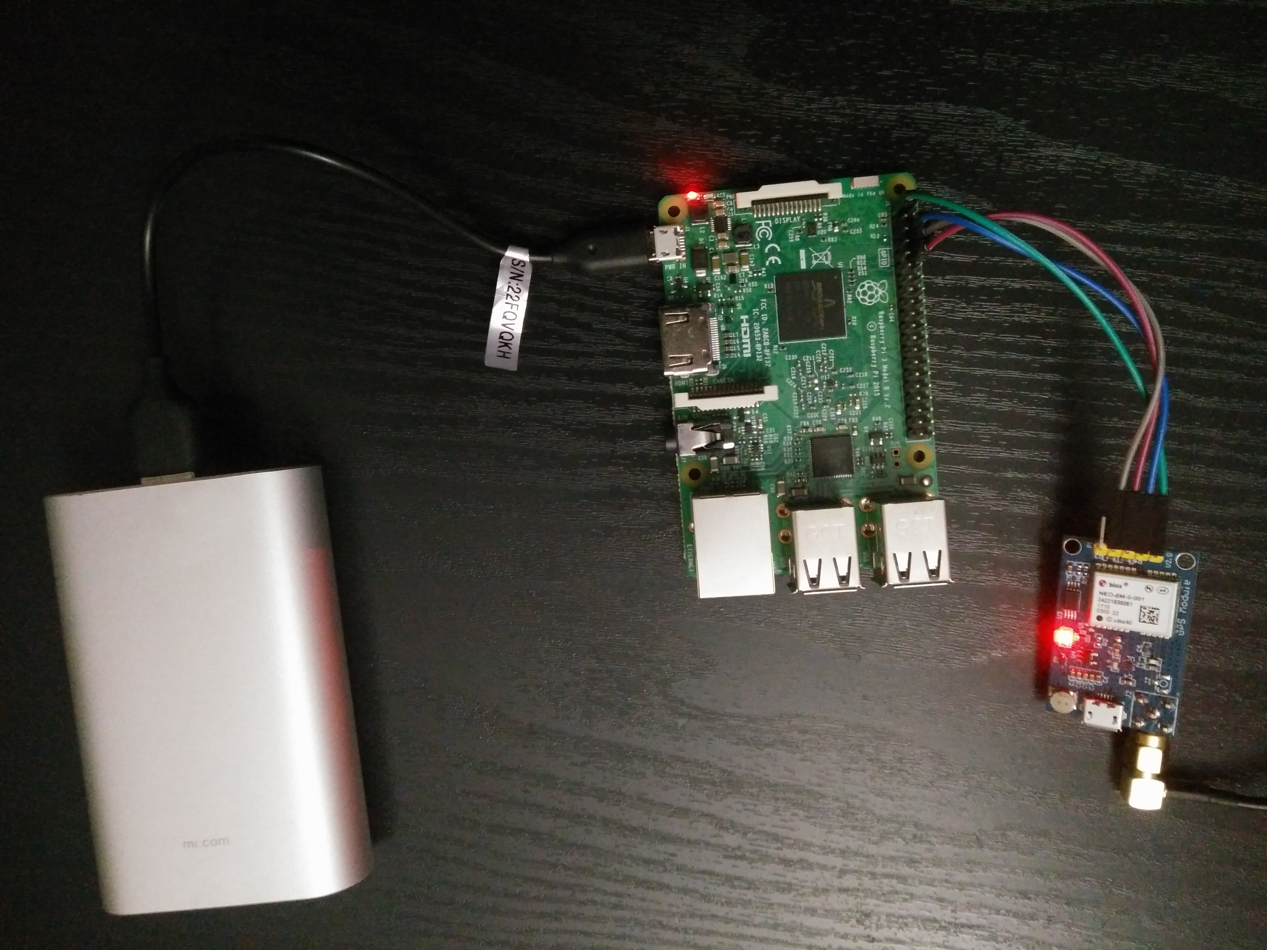
Raspberry Pi 3 and GPS

Slide 7
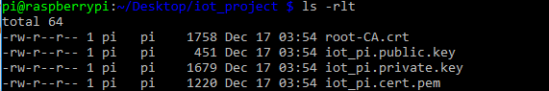
AWS IoT
Register the device.
Creation of credentials.
Attach the credentials to the device.
Use of AWSIoTPythonSDK.MQTTLib

Slide 8
Geo-fencing
The application starts when the device starts up.
Cronjob: tracker_app.sh
GPS tracker application: gps_tracker_app.py
Sends data to AWS and logs in a file.
distance_threshold = 10 , parameter controls whether to send the data or not.
Haversine function

Slide 9
Demo
How to send data to AWS.
How geofencing works in our application.

Slide 10
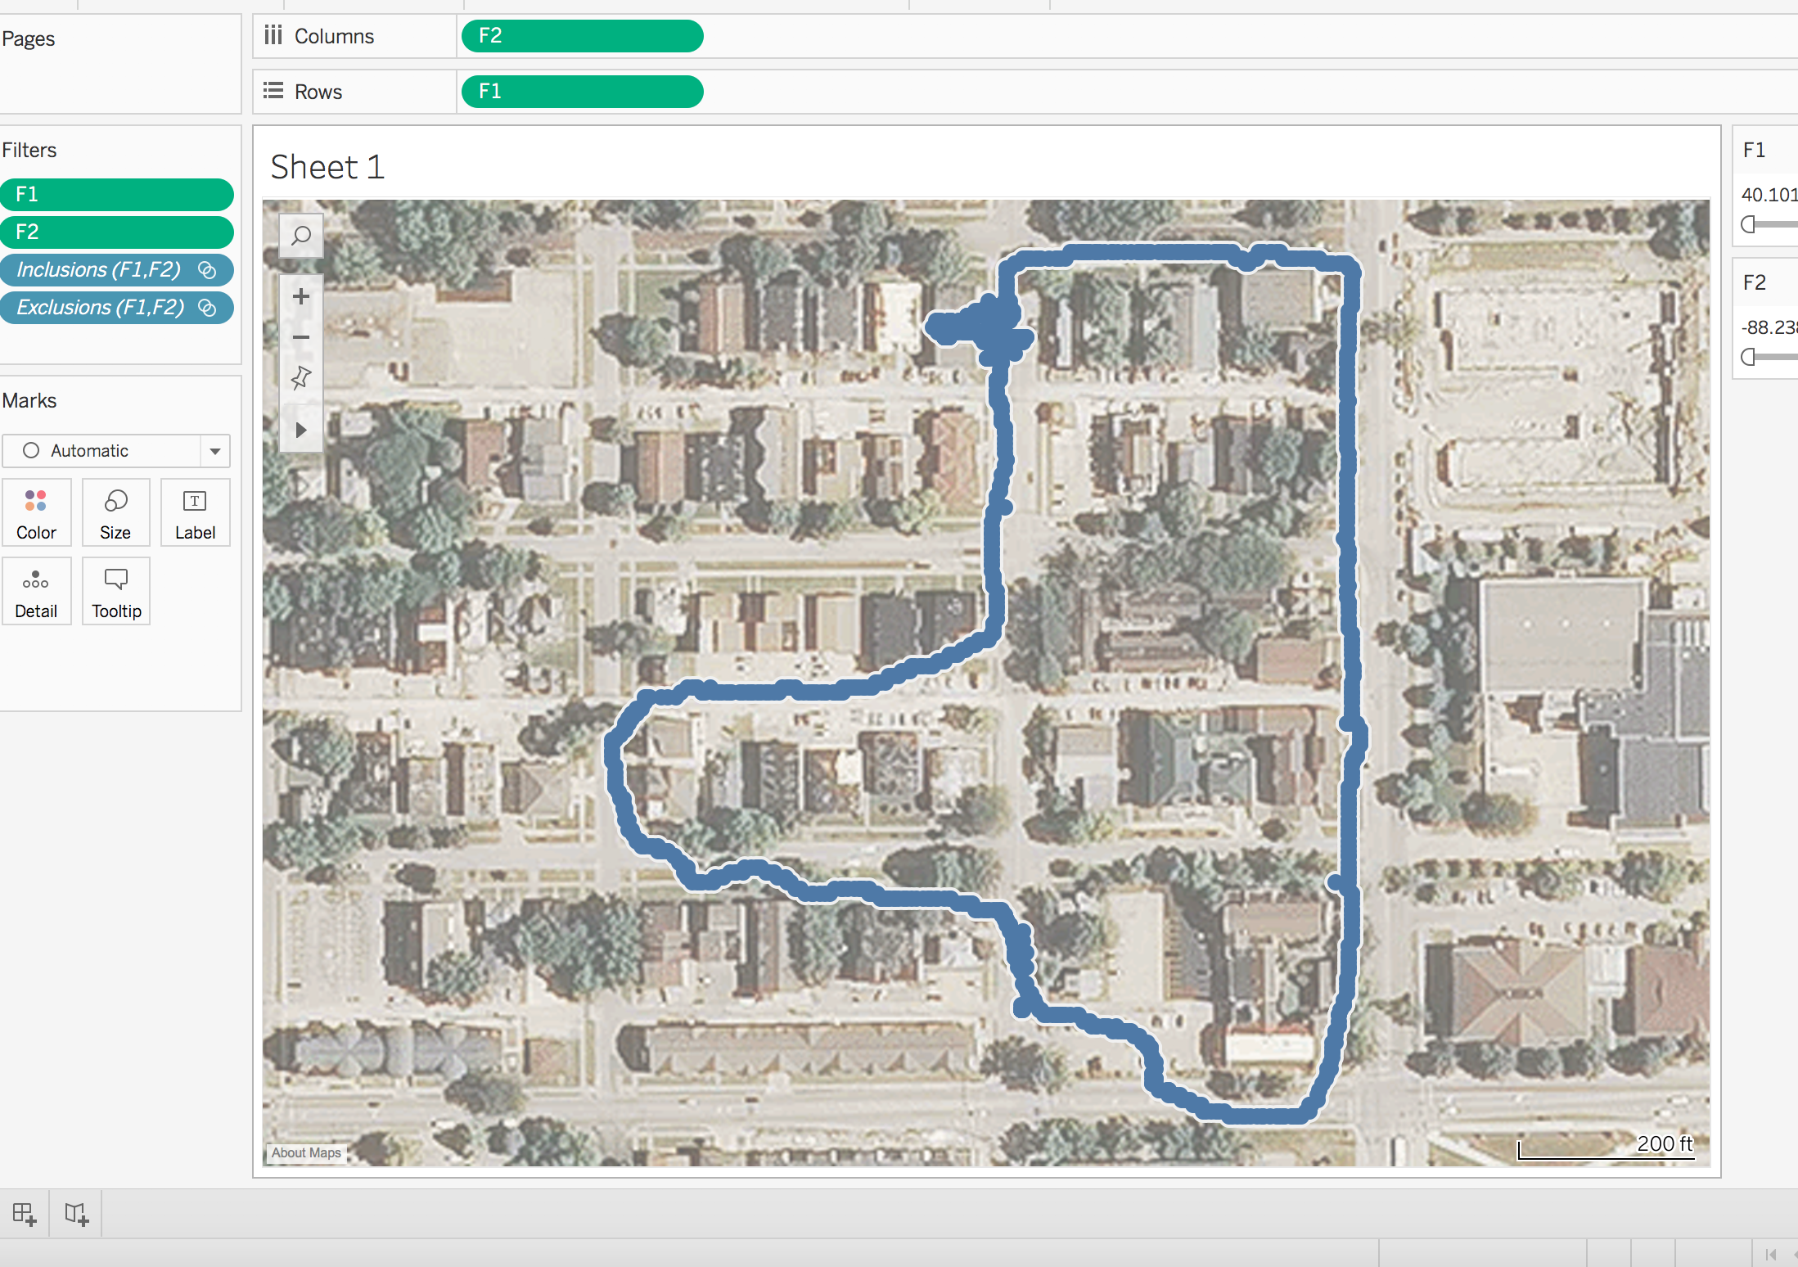
Visualization

Slide 11
Issues/Resolutions
OS process interfering with serial port.
Garbage data thrown by GPS Module.

Slide 12
References
GitHub Repository link:
https://github.com/pratikshrivastava/IOT_FALL17_PROJECT
References:
http://docs.aws.amazon.com/iot/latest/developerguide/iot-sdk-setup.html
http://docs.aws.amazon.com/iot/latest/developerguide/iot-ddb-rule.html
https://punchthrough.com/blog/posts/setting-up-aws-iot-with-lightblue-cloud-connect
http://techblog.calvinboey.com/raspberrypi-aws-iot-python/
http://www.gpsinformation.org/dale/nmea.htm
https://github.com/aws/aws-iot-device-sdk-python#id3
https://raspberrypi.stackexchange.com/questions/45570/how-do-i-make-serial-work-on-the-raspberry-pi3/45571#45571

Slide 13
Thank You!!
Questions?

